Slide 1
Weekly Meeting 1
Shengya Guo, CR/AVS, 12.06.2024

Slide 2
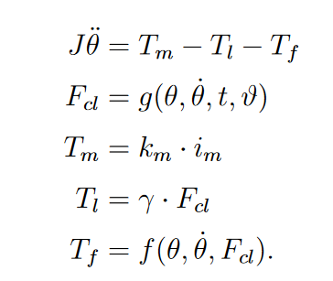


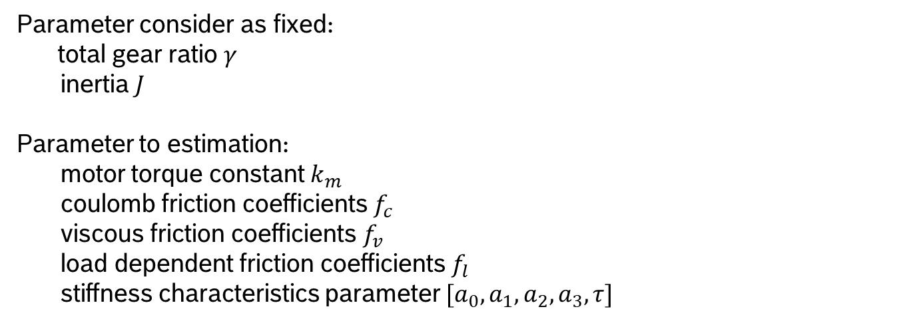
Model 1with coulomb and viscous friction model
Lumped Parameter EMB Model
Parameter consider as fixed:
total gear ratio $γ$
inertia $J$
Parameter to estimation:
motor torque constant $k_{m}$
coulomb friction coefficients $f_{c}$
viscous friction coefficients$f_{v}$
load dependent friction coefficients$f_{l}$
stiffness characteristics parameter $[{a_{0}, a}_{1}, a_{2}, a_{3}, τ]$

Slide 3
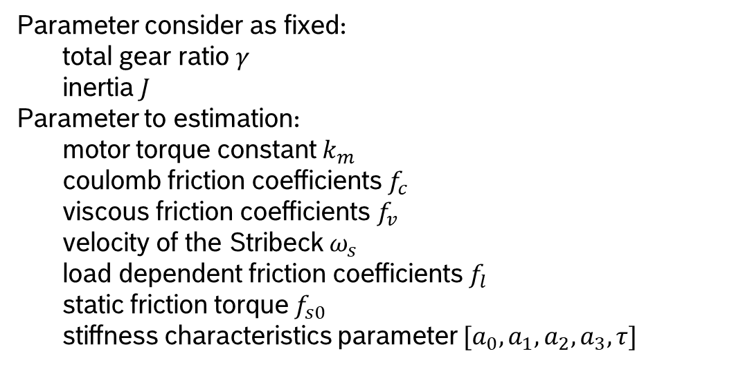
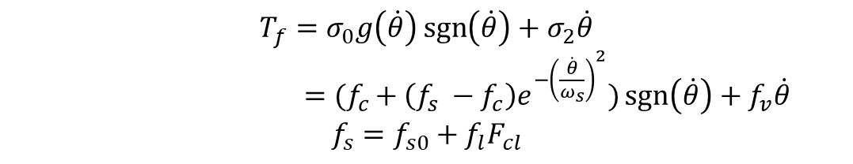
Model 2 with LuGre Model in steady state
Lumped Parameter EMB Model
$$T_{f}=σ_{0}g\left(\dot{θ}\right)\operatorname{sgn}\left(\dot{θ}\right)+σ_{2}\dot{θ}$$
$={(f}_{c }+ \left(f_{s} −f_{c}\right)e^{−{\left(\frac{\dot{θ}}{ω_{s}}\right)}^{2}})\operatorname{sgn}\left(\dot{θ}\right)+f_{v}\dot{θ}$
$$f_{s}={f_{s0}+f}_{l}F_{cl}$$
Parameter consider as fixed:
total gear ratio $γ$
inertia $J$
Parameter to estimation:
motor torque constant $k_{m}$
coulomb friction coefficients $f_{c}$
viscous friction coefficients$f_{v}$
velocity of the Stribeck $ω_{s}$
load dependent friction coefficients$f_{l}$
static friction torque $f_{s0}$
stiffness characteristics parameter $[{a_{0}, a}_{1}, a_{2}, a_{3}, τ]$

Slide 4
Question
Should temperature be considered?

Slide 5
Next
Stiffness Model need to be built and test on the Test Bench
Use conventional approaches find the nominal parameter?

